Slide 1
NSRIC Inc. (Nature Science Research and Innovation Centre)
Ontario (ON), Canada
Online Education (OE) Division
Essentials of Marketing
Instructor: Kathy Chen
Marketing Program, OE Division
NSRIC Inc.
London, ON, Canada
E-mail: kathyjchen18@gmail.com
https://www.nsric.ca

Slide 2
Week 2: Customers and Competition
Content covered in this week:
1.3 Competition
1.4 Perceptual Map
1.5 Game Theory

Slide 3
Week 2: Competition
1.3 Competition
1. Who is the competitor?
This lesson provides an overview on the aspect of competition. We will explore how marketing managers identify competitors and perform competitor analyses using perceptual maps and game theory-based approaches.
Competition is offering specific. Each offering meets a certain need of the consumers and all offerings in the market that meet these needs are meaningful competitors.
Current competitors and potential competitors
Think about any product or service that you are interested in, for example, smartphones. When we think of competitors, it is usually the most current competitors that come into our minds. For example, if you have an Apple phone, you might think of Samsung or Huawei or Sony.

Slide 4
Week 2: Competition
1.3 Competition
Types of potential competitors
Same need but different customer segment
The first kind of competitor is the one whose product offerings satisfy the same needs of the consumer as our own product does, but which is currently marketing to a different customer segment. For example, if you are, say, Coke, Coke satisfies thirst and caffeine needs. Juice and water also satisfy thirst needs, but they are in the market for non-caffeine needs. The firms offering juice and water could in the future start marketing products to Coke’s target group, ie, they could become a potential competitor.
Same customer segment but different need
A second type serves the same customer segment but different needs. So, while Coke is serving a segment requiring quick energy – a non-sports segment – Gatorade, as a sports drink, is also meeting needs of energy and fuel, but currently targeting sportspeople. This brand could be potential competition to Coke and move into non-sports segments, as long as it can satisfy on energy.

Slide 5
Week 2: Competition
1.3 Competition
Different customer segment and different need
The third kind is one that is currently serving a different segment and satisfying a different need but which could compete in the future. For example, if people are looking for caffeine, there are solid coffee toffee or chewable caffeine bars nowadays, for people who need to stay awake. These are not beverages to quench thirst. Therefore, the offering is targeting a segment that needs caffeine to stay awake and because the product is not a drink, it is not a group that Coke currently targets.
To sum up, they weren't the same industry, they weren't even a liquid drink, but now these caffeine energy bars are becoming competitors. Finally, a simpler but more recent example: products called cameras! Before smartphones, consumers had cameras to take photos and phones to make calls – different needs and different segments. Then, along came the smartphone, and if the camera manufacturers had not foreseen a very different industry (phones) taking away their business, i.e., potential competition, they would have lost out. Potential competitors are those that currently do not compete but could compete with an offering in the future.

Slide 6
Week 2: Competition
1.3 Competition
Competition from a firm’s perspective: strategic groups
When a set of firms engage in the same activity, in the same way, they are called strategic groups. They share similar activities, targets and positioning. For example, Coke, Pepsi, Dr Pepper and other caffeinated beverage brands do similar things: they tend to create value by meeting the same needs (thirst). Even if they are not providing caffeinated drinks, they are are still doing similar things, making similar strategic moves and using similar kinds of advertisements.
If you belong to a strategic group with a number of other firms, it’s very likely that they are your competitors. For example, car manufacturers are strategic groups. Cars are quite similar on design, how they make money in the market, the kinds of advertisements they create, the kinds of product lines they have, starting from sedans to SUVs, and hence they are competitors to each other.

Slide 7
Week 2: Competition
1.3 Competition
2. Consumer-based approaches: cross-price elasticities
Let’s explore a third, slightly more technical way of working out who is a competitor and how much of a competitor they are. The way to know if you are really competing with a particular product or not is to look at what we call price elasticities:
Price change | Change in my sales
Decrease in my price | Increase
Decrease in competitor price | Decrease
Decrease in substitute price | Decrease
Decrease in complement price | Increase
If a decrease in the price of a product decreases my sales, this product is a source of competition for my product (brand).

Slide 8
Week 2: Competition
1.3 Competition
A decrease in my price increases my sales
When a firm decreases its own prices, or when a
particular product’s price goes down, its own sales
will increase because as the price drops, people
buy more.

Slide 9
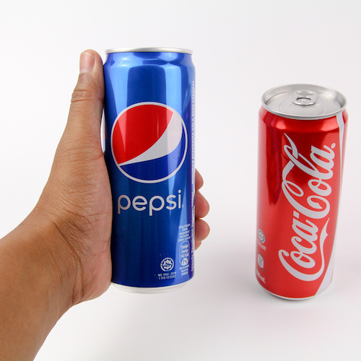
Week 2: Competition
1.3 Competition
A decrease in a competitor’s price decreases my sales
Next, if a decrease in a product’s price decreases my sales, they are clearly a competitor. If I am Coke and Pepsi reduces its price per bottle of Pepsi-Cola, what will happen? People will buy more Pepsi, so Pepsi’s own sales will go up, but because people are buying more Pepsi (assuming that these people are not extremely brand-loyal) fewer people will buy Coke. Because Pepsi is now on sale, Pepsi’s sales will increase but Coke’s will decrease. Thus, if a
competitor drops its prices and my sales dip, that
is another way to be very sure of how close the
competition is.

Slide 10
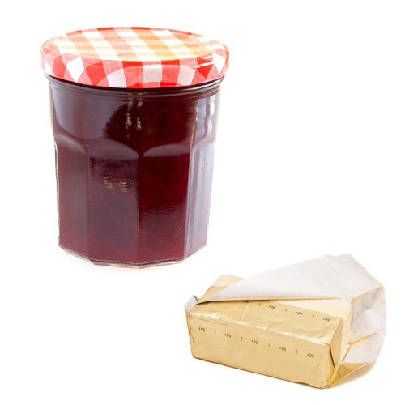
Week 2: Competition
1.3 Competition
A decrease in a substitute’s price decreases my sales
The next scenario that you should be aware of is a decrease in a substitute’s price decreasing sales. Now, two brands of butter are competitors, but if I replace butter with jam – that is if the consumer is willing to switch between butter and jam – then jam is a substitute. Thus, when jam prices drop, jam’s own sales will go up, but butter sales will go down. So, a decrease in a substitute’s price will
decrease my own sales

Slide 11
Week 2: Competition
1.3 Competition
A decrease in a complement’s price increases my sales
The final term that you should be confident with is a ‘complement’ (with an ‘e’). What is a complement? Think of printers and ink cartridges, or razors and blades. These are complements: things that go together. If we reduce the price of a printer, its own sales will go up, but because more printers have been sold, there will be greater sales of ink as well. Similarly, if you drop the price of razors, more razors get sold, which means that there will be more sales of blades too.
So, a decrease in a complement’s price will
increase my own sales. Please be very careful
and remember these technical rules regarding
competitors.

Slide 12
Week 2: Competition
1.4 Perceptual Map
1. The concept and benefits of perceptual maps
Perceptual maps: how consumers view our brand
A perceptual map is really about how consumers look at our brand based on their individual perceptions.
Perceptual maps allow marketing managers to discover three things:
how consumers view their brand
which brands they consider to be their closest competitors
which attributes seem to be most responsible for these perceived differences.
Not only will we be looking into what the consumer’s beliefs are, but we will also know which brands they think are similar to our brand.

Slide 13
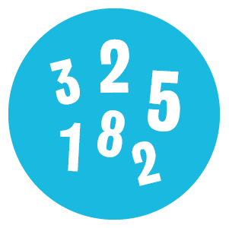
Week 2: Competition
1.4 Perceptual Map
The benefits of creating a perceptual map
Why would we want to do this? What are the benefits?
Visual presentation of information
As it is visual, a perceptual map is very amenable to being
quickly looked at when managers need to make decisions.
Quantitative data
A perceptual map is a technical formal method based on
quantitative data.
Useful for multiple purposes
It is very useful for getting a managerial feel, launching a new
product or for situations when you want to change a certain
attribute of your product a little bit.

Slide 14
Week 2: Competition
1.4 Perceptual Map
2. Step 1
The first step is to ask consumers to identify important attributes and evaluate brands.
Imagine that we want to launch a new beer on the market. The following example explains how to create the perceptual map to analyze the competition existing in the market.
First, we conduct preliminary interviews and surveys with customers to select a set of attributes. At this stage, we ask them what attributes are important to them. We also identify a set of brands
by creating focus groups and asking consumers
about a whole list of brands that we think they
may consider to be our competitors. Finally, we
have customers evaluate all of these brands on
those attributes.

Slide 15
Week 2: Competition
1.4 Perceptual Map
3. Step 2
The second step is to select the most important attributes.
Using the data we have collected in the previous step, the next thing to do is to compute the average attributes for each of these brands. Marketers do this by using factor analysis (many softwares to do this are available).
This technique identifies the most important attributes. If you look at the picture in this case, the two most important attributes that were identified were whether the beer was heavy or light (plotted on the Y-axis) and whether it was a premium-price product or a budget-price product (plotted on the X-axis).

Slide 16
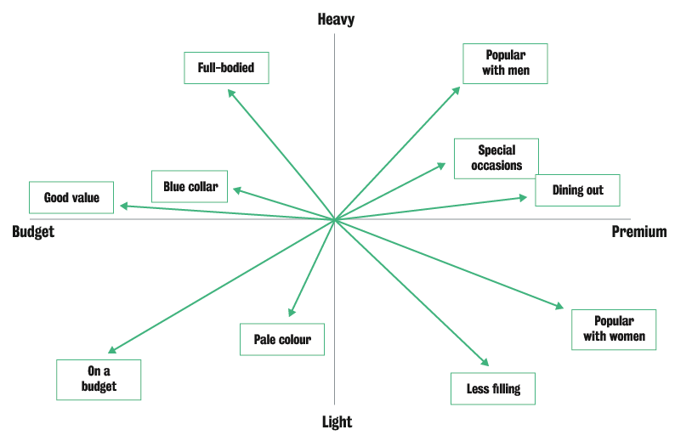
Week 2: Competition
1.4 Perceptual Map
3. Step 2
Next, we plot the rest of the attributes on the map in the sense of factor analysis (in blue boxes). If you look at the upper right-hand side, between the attributes 'heavy' and 'premium', you
will see such attributes as
‘popular with men’, and then,
‘dining out’ and ‘special occasions’.
If you look at the
lower right-hand side,
between the attributes
‘premium’ and ‘light’,
you will find
attributes like
‘popular with women’, ‘less filling’, and so on.

Slide 17
Week 2: Competition
1.4 Perceptual Map
4. Step 3
The third step is to plot the brands.
The next step is to plot the beer brands on this graphic. Remember that we had them rated (in step 1), so we have a number for each beer on each attribute. We use these ratings to plot the beer brands on the map. Looking at the full map will help us to understand competition.
For example, look at where Michelob is plotted in the chart: Michelob is considered a premium beer, and it is used quite often for dining out, therefore it is on the right hand side of the chart. It is also considered a reasonably light beer, therefore it is located below the x-axis. Something very similar to this is Beck’s. It’s slightly more premium and it’s heavier than Michelob.

Slide 18
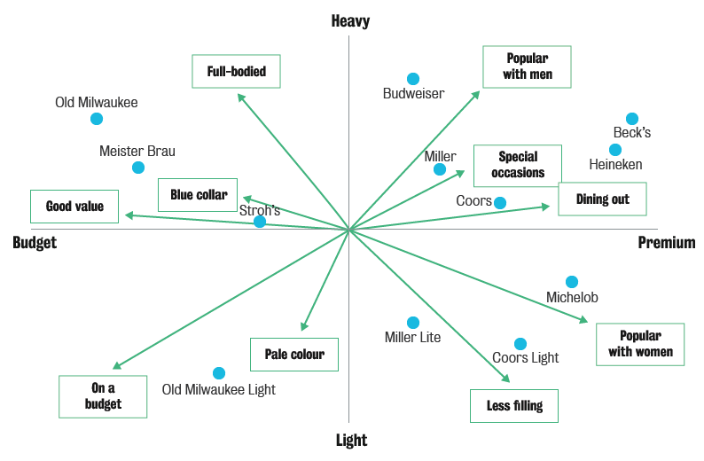
Week 2: Competition
1.4 Perceptual Map
4. Step 3

Slide 19
Week 2: Competition
1.4 Perceptual Map
5. Step 4
The fourth step is to observe areas with more and with less competition.
If we are looking to launch a new premium beer, not as heavy as Beck’s and not as light as Michelob, we would probably want to put it below Beck’s and above Michelob, and then decide on the price. Our aim is to be positioned in the premium dining or premium area. (See pink area with thick border).
If it is more of a budget beer we are thinking of, look at the area between the beginning of the budget axis and the end of it. There is nothing really there except Stroh’s, which is just above that X-axis, if we want to have a budget beer which is light. (See purple area with dashed border).
Old Milwaukee Light is really light. It is the only one in that area, so this seems to be a quadrant where we can have a budget brand that is light. There is a lot of space available, and there are no competitors (see blue area with thin border). Now, if it’s a budget brand, we are likely to have a lower price, so is it worthwhile for you to build up a budget brand? This is something we want to consider.

Slide 20
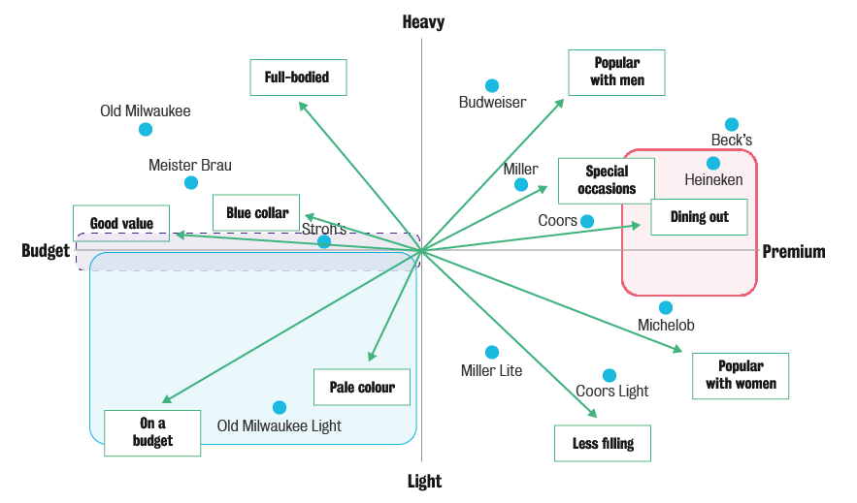
Week 2: Competition
1.4 Perceptual Map
5. Step 4

Slide 21
Week 2: Competition
1.4 Perceptual Map
6. Step 5
The final step involves observing how close our competition is.
As a snapshot of where we have more competition, we could say that Beck’s and Heineken are very strongly competing on the premium-and-heavy range. If we need to know exactly how close our competition is, we can draw a dotted line from Heineken to the X-axis and from Heineken to the Y-axis, (see red lines on graphic), and we can do this similarly from Beck’s (see brown lines on graphic). You will see the exact distance in numbers as to how far or how close they are.
At the end of this exercise, we will have a map of the closeness of competition and we will also have a visual review to take a look at. This is another benefit that having a perceptual map provides.
Among the many uses of perceptual maps in the marketing context, we highlight the following:
understanding the market structure of product categories, as perceived by customers
selecting the set of competitors to compete against
evaluating new product concepts.

Slide 22
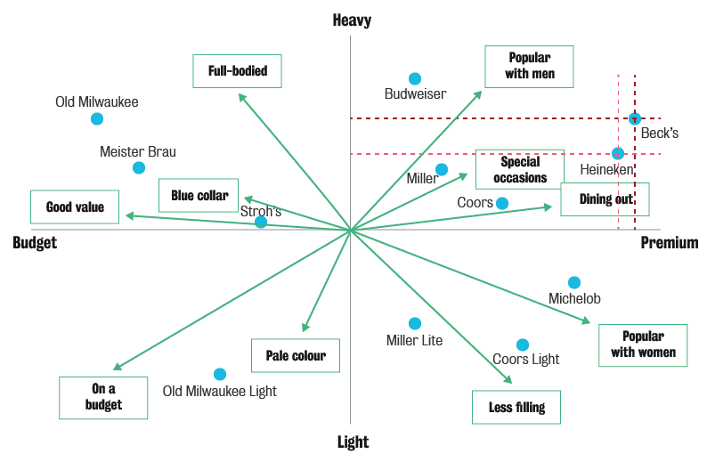
Week 2: Competition
1.4 Perceptual Map
6. Step 5

Slide 23
Week 2: Competition
1.5 Game Theory
1. Introduction to game theory
Essential terminology
There are some terms that you will want to be aware of, namely: players, actions, payoffs and strategies.
Players are the parties, firms or individuals – at least two – who will make certain decisions or take certain actions. Based on those actions, players will get some rewards or profits, called payoffs.
Game theory basically says that decisions are made in situations of strategic interdependence. This means that your profits are dependent on my actions and my profits are dependent on your actions.

Slide 24
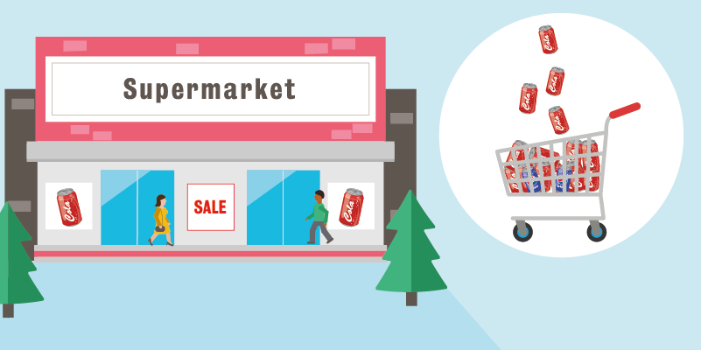
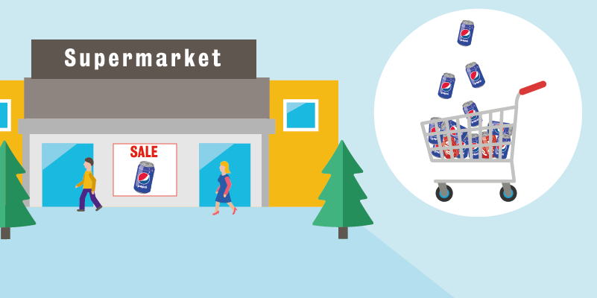
Week 2: Competition
1.5 Game Theory
1. Introduction to game theory
Let’s take a very simple example using two
firms, Coke and Pepsi:
If Coke increases advertising, Coke’s total
sales will go up, and at the same time,
Pepsi’s sales will go down because some
people who would have bought Pepsi are
buying Coke. Coke’s action has an effect on Pepsi.
Now, Pepsi might turn around and increase
its own advertising so that it regains some
of that market share from Coke, and Coke
starts to suffer. This is strategic
interdependence.

Slide 25
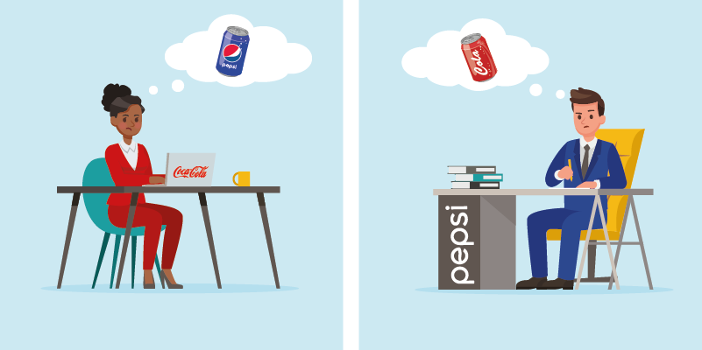
Week 2: Competition
1.5 Game Theory
1. Introduction to game theory
Managers at both Coke and Pepsi need to be aware that it is not just what they are doing but also their
response to what their
competitor is doing that will
affect their profits. In other
words, I know what you do
will affect me, and you know
that my reactions will affect
your profits. That is what
strategic interdependence is.
What is strategic interdependence?
Your payoffs (profits) depend not only on your actions but also on the actions of others (competitors).

Slide 26
Week 2: Competition
1.5 Game Theory
2. The prisoners’ dilemma
Here we will talk about one particular game, which is well-known as the prisoners’ dilemma:
There are two burglars, Gerry and Ted, who get caught by the police. They are separated and questioned simultaneously (simultaneous). They can’t talk to each other, and secondly, they can’t know what the other burglar is saying or doing (non-cooperative).
If one burglar confesses first, they will get less jail time. This is an offer the police can make in the US.
Both Gerry and Ted have two options: one is to not confess and the other is to confess. The graphic below illustrates the possible scenarios that Gerry and Ted might face:

Slide 27
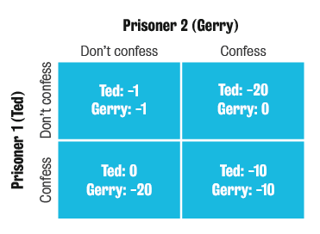
Week 2: Competition
1.5 Game Theory
2. The prisoners’ dilemma
Top left box: If neither Gerry nor Ted confess, they will both get one year of jail. Yes, they will go to jail, but for one year only.
Top right box: If Gerry confesses by saying something like: 'I didn’t do it' or 'I will tell you everything about it if you let me go, it’s my partner Ted who did it…' then, Ted will go to jail for
20 years and Gerry will go free.
Bottom left box: If Ted confesses
but Gerry doesn’t, Gerry will
get 20 years in jail and Ted
will go free.
Bottom right: If Ted confesses
and Gerry also confesses,
each will go to jail for 10 years.

Slide 28
Week 2: Competition
1.5 Game Theory
2. The prisoners’ dilemma
Because they cannot talk to each other and must make decisions at the same time, Ted will think ‘I will save myself and confess’, and Gerry will also think ‘I will save myself and confess’ – and they will each go to jail for 10 years.
If they could talk, they would not confess, and they would both go to jail for only one year. However, because it is a non-cooperative, simultaneous game, they both get trapped, thus prisoners' dilemma.
It would be ideal if Ted could talk to Gerry or have some way of making a promise or agreement. For example, Ted could say 'hey Gerry, don’t tell them anything' or, Gerry could say 'Ted you don’t tell them anything, let’s be together; after one year of jail time we can get our loot back'. However, because they can’t talk to convince each other, they both end up in a worse situation.
Thus, confess-confess (also called cheat-cheat) is the equilibrium in this game. This has been tested many times.

